Slide 1
RWI Phonics Parent Meeting
Notes:
Welcome to a brief taster of our whole school synthetic phonics literacy programme – Read Write Inc!
Please insert own notes for introduction/welcome.

Slide 2
Children who read at home do well at school
Read fluently
Write confidently
Speak articulately
Notes:
“Reading is the one ability, that once set in motion, has the ability to feed itself, grow exponentially and provide a basis from which possibilities are endless.” Michael Morpurgo

Slide 3
So what is Phonics?
Learning to hear and read sounds.
Breaking words into sections to blend.
Understanding Phonics

Slide 4
Why Phonics?
A complete literacy programme - systematic and structured.
Meets the demands of the new national curriculum, giving your children the best chance of success in the national tests.
One-to-one tutoring - no child is left behind.
Storybooks align with the sounds learnt in class.
What is Read, Write Inc Phonics?
Notes:
Read Write Inc. Phonics is systematic and structured –
every teacher has the skills to teach any child to read.
The programme meets the demands of the new national curriculum –
your children have the best chance of success in the national tests.
Assessment is rigorous and effective – one-to-one tutoring ensures that no child is left behind.
Your children are thoroughly supported – the resources match your child’s learning in class and they can share them with you at home.

Slide 5
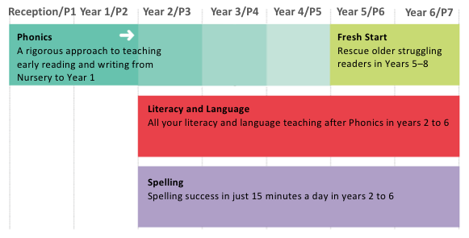
Who is Phonics for?
Notes:
Delete as appropriate to what happens in your school after Phonics.
Phonics is usually taught in Reception and Year 1 but many schools are enjoy early success in Nursery.
Most children should be fluently reading, without Phonics, by Year 2. These children move onto Read Write Inc. Literacy and Language.
Phonics is also great for older children who need to catch up and children new to English. These children use Read Write Inc. Fresh Start.

Slide 6
A bit of technical knowledge…
Phonics = the sounds in our language.
Watch our sound pronunciation guide.
Now it is your turn to practise…
Notes:
This video is available on the RMT website and Facebook page

Slide 7
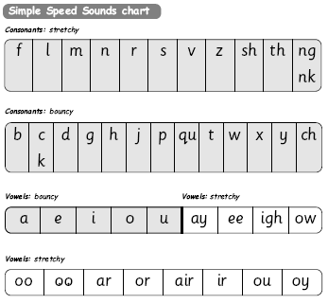
Notes:
Go through these sounds quickly with parents using My Turn/Your Turn.
Stress you must not use letter names at this stage – just pure sounds.
Emphasise getting rid of ‘ugh’ to help blending. Parents usually love this bit! Make it fun! Set 1 then long vowels in Set 2.
Explain that when the children are taught the sounds they use the cards and a multi-sensory approach – hold up the cards again.

Slide 8
The English language is a complex code…
It would be easy if we only had to learn Set 1 and Set 2 sounds.
ay | igh
play eight cake straight | right spie kite fly
Set 3 sounds

Slide 9
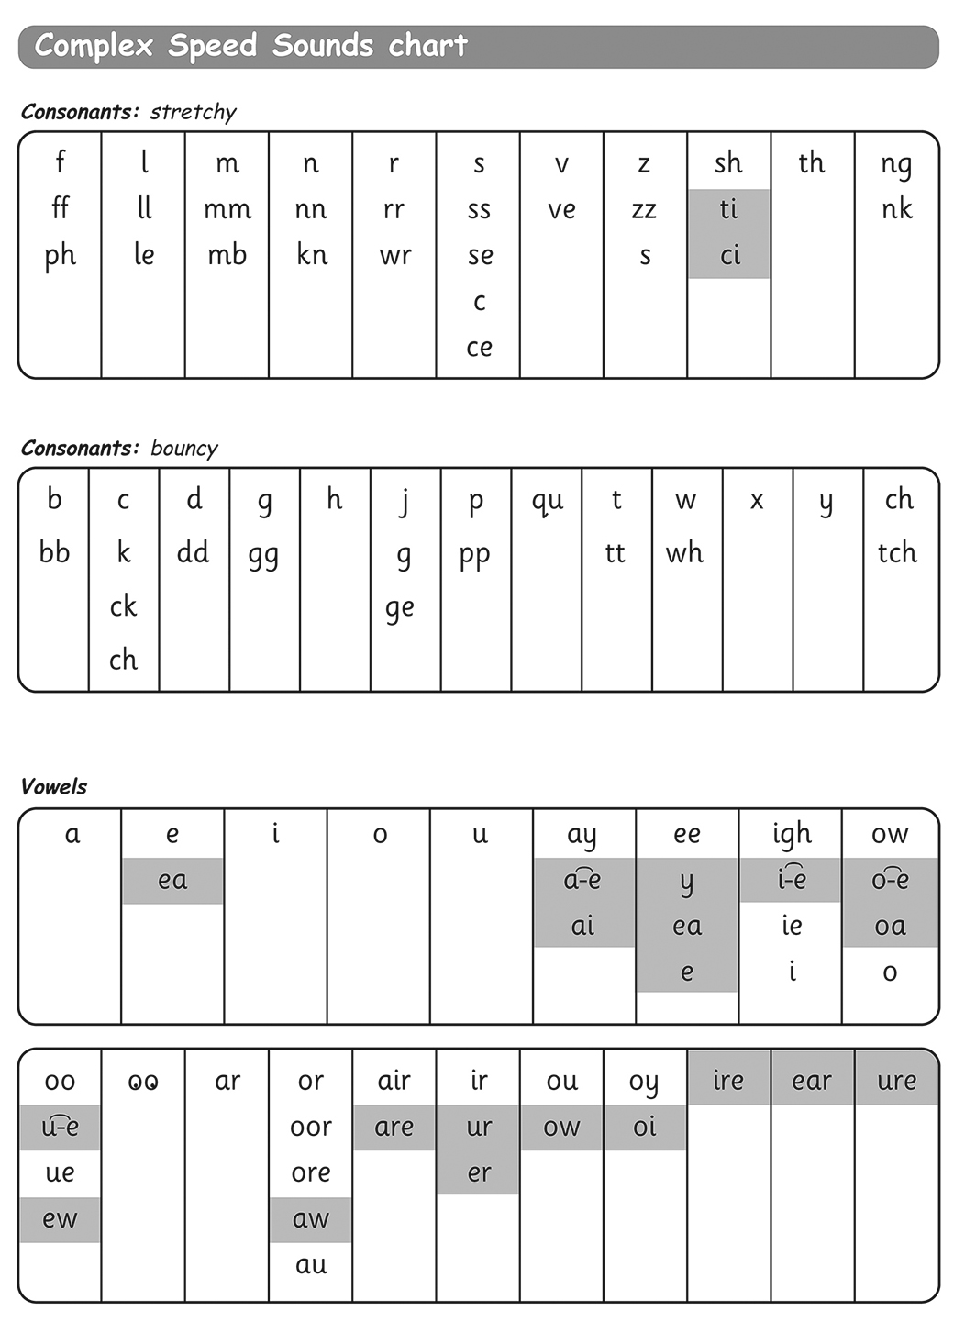
Notes:
Explain again the sound boxes and say this chart show the many different graphemes for the same sounds! No other language has as many to learn! Pink graphemes are Set 3 – explain they only learn these once they know all of Set 1 & 2 effortlessly – systematic and structured!

Slide 10
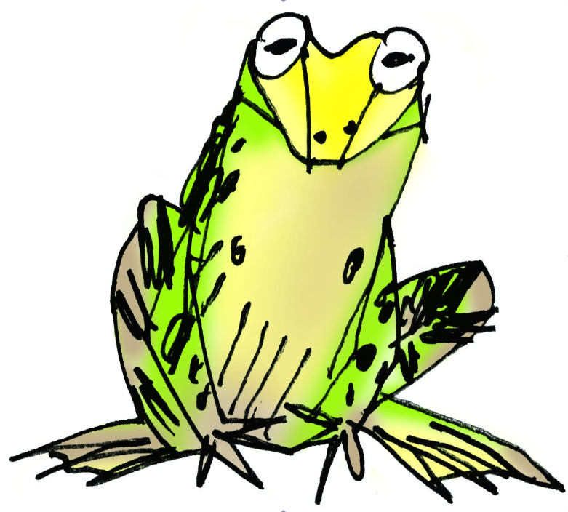
How do phonics help us read?
Say “hello” to Fred.
Fred can only talk in sounds...
He says “c_a_t.” Not cat.
We call this Fred Talk.
Watch Ruth Miskin explains Fred Talk.
Notes:
Hold up Fred! Say you too can have a Fred at home – use one like this or any stuffed toy. Watch the video for a demonstration of how to Fred talk.

Slide 11
Who supports our school?
Ruth Miskin Training
provide whole-school training
in the Phonics programme.
The trainer continues to support us
on in-school Development Days.
Notes:
Read Write Inc. created by one of the UK’s leading authorities on literacy, Ruth Miskin.
Both the training and Development Days are rated outstanding by the Department for Education.

Slide 12
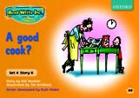
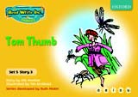
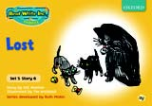
Oxford University Press publish the resources
Notes:
Every day, your child will read and write the words that contain the sounds and graphemes they have learned so far, using lively, fun, phonic storybooks and a Get Writing book. Hold up some Storybooks and Get Writing Books. There are lots of non-fiction books as well! Show a few.

Slide 13
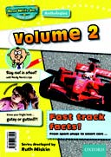
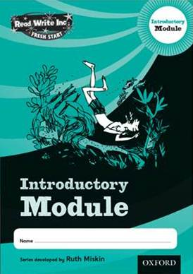
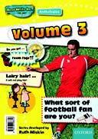
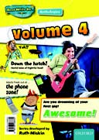
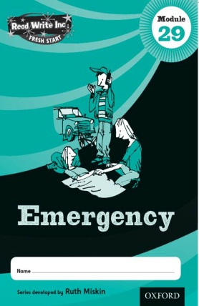
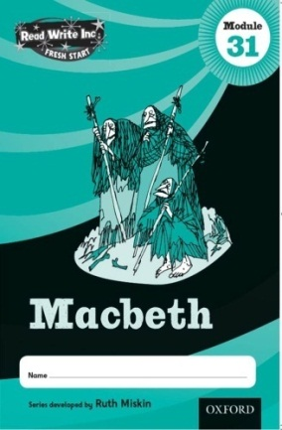
Fresh Start Modules: reading and writing.
Notes:
Optional slide showing Fresh Start resources for older pupils (Y5 onwards) who need to catch up quickly.

Slide 14
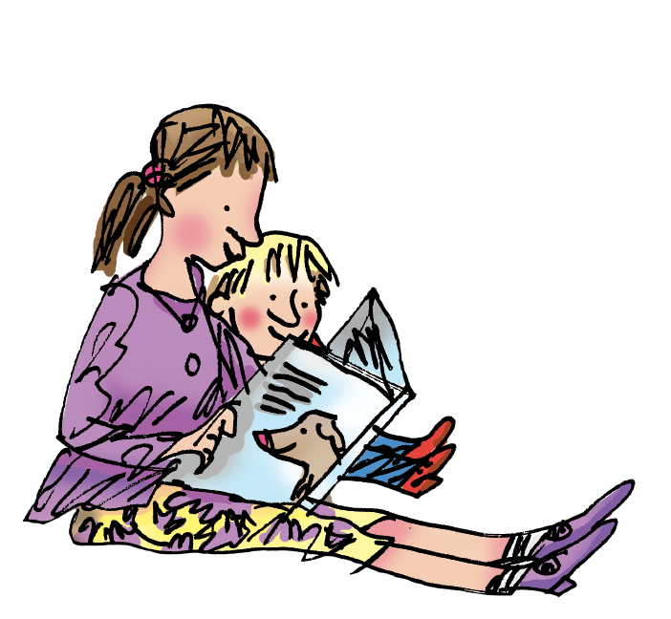
How to help your child at home…

Slide 15
You can read stories with your child. Relentlessly.
Read favourite stories over and over again
Read some stories at a higher level than they can read themselves.
Listen to them reading their take home Phonics storybooks.
Watch our storytime at home video.
Notes:
View the Ruth Miskin Training suggested reading lists for great books to read with your children.
http://www.ruthmiskintraining.com/teacher-support/tag-44/index.html

Slide 16
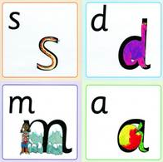
You can practise pronouncing sounds.
Remember no ‘fuh’ and ‘luh’!

Slide 17
You can have fun with Fred Talk.
“What a tidy r-oo-m!”
“Where’s your c-oa-t?”
“Time for b-e-d!”
Notes:
Give a couple of examples e.g. Where is your c_oa_t? Time for b_e_d! Make sure your child can tell you what the word is.
Use only single syllable words (no Fred Talking multi-syllabic words) and only the last word in a sentence or it gets very silly! E.g. P_u_t o_n y_our b_l_ue c_oa_t (you’ll never get out!).

Slide 18
You can watch video tutorials.
For how to do all these things and more www.ruthmiskintraining.com/parents
Notes:
If you have time then you could watch the one to one parent tutorial ‘How to teach a Set 1 Sound’

Slide 19
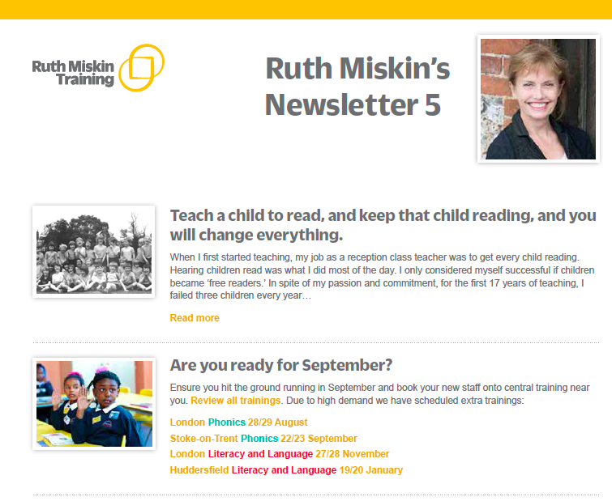
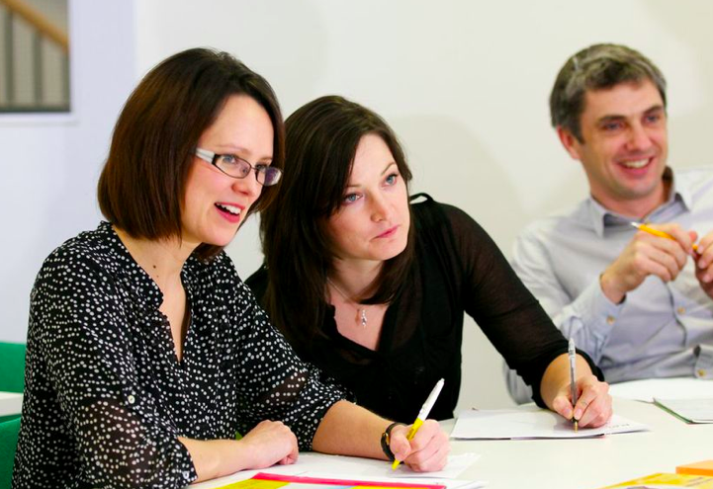
You can also…
Ruth Miskin Training parents’ page – trainer top tips and book recommendations.
Sign up to the Ruth Miskin Training newsletter on the website homepage.
Attend the training for yourself at central locations across the UK.
www.ruthmiskintraining.com
You may be interested in Grammar training for adults and Handwriting.

Slide 20
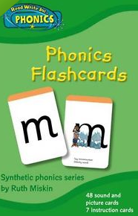
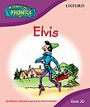
You can order the resources online.
https://global.oup.com/education/content/primary/series/rwi/parents/
Notes:
Hold up an example of these resources.
You could also explain about One-to-one Tutoring.
If you have the One-to-one Tutoring kit in school you could show this. Explain that this is designed to help slowest progress readers make accelerated progress by working on a 1:1 with an adult for 10 - 20 mins a day. There is a handbook in the One-to-one Tutoring box to guide the adult and Ruth Miskin Literacy provide training in this as well.

